Slide 1

Outlines
  <number>/57
Representing a Mesh
  Geometry vs Topology
  Two methods of Representing Cube
Transformation Cube（*）
Analog tracking ball（*）
Quaternions for Rotation
chap4.6 建模一个彩色立方体
chap 4.11~4.14: WEBGL如何实现变换~cube,trackball实例
Notes:
chap4.6 建模一个彩色立方体
chap 4.11~4.14: WEBGL如何变换

Slide 2
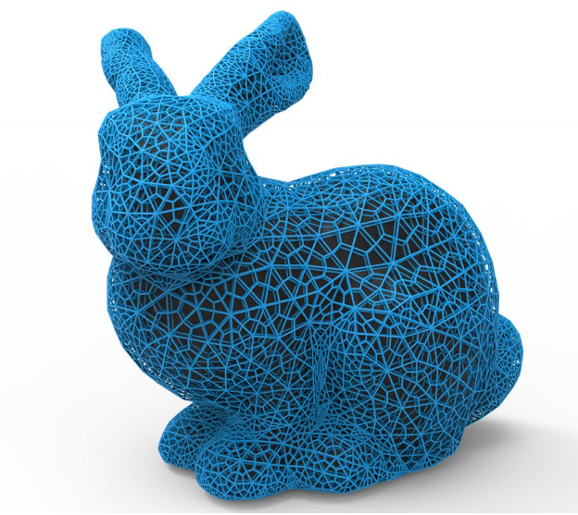
Representing a Mesh(网格)
  <number>/57
e₂
v₅
v₆
e₃
e₉
e₈
v₈
v₄
e₁
e₁₁
e₁₀
e₇
v₇
e₄
v₁
e₁₂
e₆
v₃
e₅
v₂
There are
  8 nodes(vi)~ vertex
  12 edges(ei)~ 6 interior (shared) edges
  5 interior polygons,
Each vertex has a location v_{i} = (x_{i} y_{i} z_{i})
Notes:
斯坦福兔子网格图

Slide 3
Geometry vs Topology
  <number>/57
  Geometry: locations of the vertices
  几何：每个顶点的位置坐标。
  Topology: organization of the vertices and edges
  拓扑：顶点之间的关联关系。
  data structures separate the geometry from the topology,
  几何性质改变了，拓扑关系可以不改变
Notes:
a polygon is an ordered list of vertices with an edge connecting successive pairs of vertices and the last to the first。Topology holds even if geometry changes

Slide 4
1)Simple Representation~Vertexts
  <number>/57
Define each polygon by the geometric locations of its vertices
多边形只采用几何表示，即顶点序列来表示
e₂
v₅
vertex.push(vec3(x1, y1, z1));
vertex.push(vec3(x2, y2, z2));
vertex.push(vec3(x7, y7, z7));
v₆
v₈
e₃
e₈
e₉
v₄
e₁
e₁₁
e₁₀
vertex.push(vec3(x2, y2, z2));
vertex.push(vec3(x3, y3, z3));
vertex.push(vec3(x4, y4, z4));
vertex.push(vec3(x7, y7, z7));
v₇
e₄
v₁
e₇
e₁₂
e₆
v₃
e₅
v₂
……
Inefficient and unstructured(效率低+非结构化)
当顶点位置改变，须找到所有顶点出现的地方进行修改
Notes:
occurrence [ə'kʌr(ə)ns] 详细»
n. 发生；出现；事件；发现
Example:
一个多边形是一个有序的顶点列表，它的边连接着连续的顶点对，最后一个到第一个。
Consider moving a vertex to a new location , must search for all occurrences and modify them.

Slide 5
2)Representation~Edge List
  <number>/57
Put the geometry in an array, the use pointers from the vertices into this array, Introduce a edge list
e1
e2
e3
e4
e5
e6
e7
e8
e9
v1
v6
x₁ y₁ z₁
x₂ y₂ z₂
x₃ y₃ z₃
x₄ y₄ z₄
x₅ y₅ z_{5.}
x₆ y₆ z₆
x₇ y₇ z₇
x₈ y₈ z₈
e₂
v₅
e₃
v₆
v₈
e₈
e₉
v₄
e₁
e₁₁
e₁₀
v₇
e₄
v₁
e₇
e₁₂
e₆
v₃
e₅
v6
v8
v₂
efficient and structured（有效+结构化）
当顶点位置改变只修改几何部分， 拓扑与几何分离。
Notes:
Note polygons are not represented!

Slide 6
  <number>/57
Edge list没有表达面face（多边形信息）
Draw the polygon by its edges, shared edges are drawn twice
Notes:
Can store mesh by edge list，
Shared Edges

Slide 7
3)Representation ~ Vertex Lists
  <number>/57
Put the geometry in an array, the use pointers from the vertices into this array,( Introduce a polygon list)
x₁ y₁ z₁
x₂ y₂ z₂
x₃ y₃ z₃
x₄ y₄ z₄
x₅ y₅ z_{5.}
x₆ y₆ z₆
x₇ y₇ z₇
x₈ y₈ z₈
e₂
v₅
v₁
v₇
v₆
v₆
v₈
e₃
P1
P2
P3
P4
P5
e₈
e₉
e₁
e₁₁
e₁₀
v₇
e₄
v₁
e₇
v₈
v₅
v₆
e₁₂
e₆
v₃
e₅
v₂
topology
geometry
efficient and structured(高效+结构化)
当顶点位置改变，只修改一个地方。 拓扑与几何分离！
Notes:
顶点列表： 几何信息存放在一个简单的列表或数组中。
优点： 每隔顶点位置只出现一次，而不在定义每个面片重复出现

Slide 8
  <number>/57
Vertex lists will draw filled polygons

Slide 9
Outlines
  <number>/57
Representing a Mesh
Two methods of display Mesh
  by arrays
  by elements
Three methods of Transformation Cube
Analog tracking ball
Quaternions for Rotation
Notes:
chap4.6 建模一个彩色立方体mesh
chap 4.11~4.14: WEBGL如何实现齐次坐标变换软件包，提供的接口

Slide 10
Modeling a Cube~Using Vertex Lists
  <number>/57
5
6
1
2
4
7
0
3
x₀ y₀ z₀
x₁ y₁ z₁
x₂ y₂ z₂
x₃ y₃ z₃
x₄ y₄ z₄
x₅ y₅ z_{5.}
x₆ y₆ z₆
x₇ y₇ z₇
v₀
v₃
v₂
v₁
quad0
quad1
quad2
quad3
quad4
quad5
cube
Notes:
Data structureSee cube.js
注意多边形面的法向量方向

Slide 11
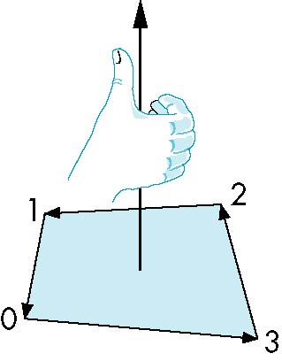
Inward and Outward Facing Polygons
  <number>/57
right-hand rule =counter-clockwise encirclement
of outward-pointing normal （外法向量 ）
5
6
1
2
4
7
0
3
OpenGL can treat inward and outward facing polygons differently
The order {v₀, v₁, v₂ , v₃} and {v₁, v₂, v₃, v₀} are equivalent in that the same polygon will be rendered by OpenGL
but the order {v₁, v₃, v₂, v₀} is different
Notes:
The first two describe outwardly facing polygons

Slide 12
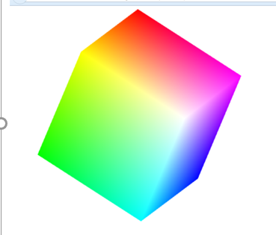
colorcube
  <number>/57
See cube.js and cubev.js
var canvas, gl;
var numVertices = 36;
var points = [];
var colors = [];
window.onload = function init(){
canvas = document.getElementById( "gl-canvas" );
gl = WebGLUtils.setupWebGL( canvas );
colorCube();
……
Notes:
Js文件Initialization

Slide 13
Quad(四边形）
  <number>/57
See cube.js
vertices are ordered, obtain correct outward facing normal
5
6
function colorCube( )
{ quad(0,3,2,1);
quad(2,3,7,6);
quad(0,4,7,3);
quad(1,2,6,5);
quad(4,5,6,7);
quad(0,1,5,4);
}
1
2
4
7
0
3

Slide 14
The quad Function
  <number>/57
See cube.js
Each quad(a,b,c,d) generates two triangles（webgl）
d
c
a
b
var quad(a, b, c, d)
{
var indices = [ a, b, c, a, c, d ];
for ( var i = 0; i < indices.length; ++i ) {
points.push( vertices[indices[i]]);
colors.push( vertexColors[indices[i]] );
//上句是smooth插值填色时使用，如果一个面填一色，用下句 //colors.push(vertexColors[a]);
}
}
Notes:
Put position and color data for two triangles from a list of indices into the array vertices
Quad: 四方

Slide 15
Vetext locations
  <number>/57
See cube.js
Define global array for vertices
var vertices = [
vec3( -0.5, -0.5, 0.5 ),
vec3( -0.5, 0.5, 0.5 ),
vec3( 0.5, 0.5, 0.5 ),
vec3( 0.5, -0.5, 0.5 ),
vec3( -0.5, -0.5, -0.5 ),
vec3( -0.5, 0.5, -0.5 ),
vec3( 0.5, 0.5, -0.5 ),
vec3( 0.5, -0.5, -0.5 )
];
5
6
1
2
4
7
0
3

Slide 16
Vetext Colors
  <number>/57
Define global array for colors
See cube.js
var vertexColors = [
[ 0.0, 0.0, 0.0, 1.0 ], // black
[ 1.0, 0.0, 0.0, 1.0 ], // red
[ 1.0, 1.0, 0.0, 1.0 ], // yellow
[ 0.0, 1.0, 0.0, 1.0 ], // green
[ 0.0, 0.0, 1.0, 1.0 ], // blue
[ 1.0, 0.0, 1.0, 1.0 ], // magenta
[ 0.0, 1.0, 1.0, 1.0 ], // cyan
[ 1.0, 1.0, 1.0, 1.0 ] // white
];

Slide 17
Render By Arrays
  <number>/57
See cube.js by arrays
Send Vertexs to GPU
var vBuffer = gl.createBuffer();
gl.bindBuffer( gl.ARRAY_BUFFER, vBuffer );
gl.bufferData( gl.ARRAY_BUFFER, flatten(points), gl.STATIC_DRAW );
Render
function render(){
gl.clear( gl.COLOR_BUFFER_BIT |gl.DEPTH_BUFFER_BIT);
gl.drawArrays( gl.TRIANGLES, 0, numVertices );
requestAnimFrame( render );}
Notes:
以三角形为基本图元绘制

Slide 18
Mapping indices to faces
  <number>/57
  使用元素数组绘制网格(see cubev.js,书 4.6.7)
  定义Indices数组，包含立方体所有拓扑信息6*2=12个三角形
  不再需要定义quad,也不需要points和colors数组
5
6
var indices =[
1,0,3, 3,2,1,
2,3,7, 7,6,2,
3,0,4, 4,7,3,
6,5,1, 1,2,6,
4,5,6, 6,7,4,
5,4,0, 0,1,5
];
2
1
7
4
0
3

Slide 19
Rendering by Elements
  <number>/57
使用元素数组绘制网格(see cubev.js,书 4.6.7)
Send indices to GPU
var iBuffer = gl.createBuffer();
gl.bindBuffer(gl.ELEMENT_ARRAY_BUFFER, iBuffer);
gl.bufferData(gl.ELEMENT_ARRAY_BUFFER,
new Uint8Array(indices), gl.STATIC_DRAW);
Render
gl.drawElements(gl.TRIANGLES, numVertices,
gl.UNSIGNED_BYTE, 0 );
Notes:
init中增加了iBuffer的创建和传递给GPU ，原来的vbuffer和cbuffer还是要创建，只是步需要生成所有顶点的数组，而是直接初始的数据数组。 GPU自动根据iBuffer去找到所有顶点或颜色数组中的相应数据进行处理。
Even more efficient if we use triangle strips or triangle fans.
render中gl.drawElements替换了gl.drawarray函数gl.drawArrays( gl.TRIANGLES, 0, numVertices );

Slide 20
Outlines
  <number>/57
Representing a Mesh
Transformation Cube（*）
  ModelView Matrix
  Program Realize
Analog tracking ball（*）
Quaternions for Rotation
chap4.6 建模一个彩色立方体
chap 4.11~4.14: WEBGL如何实现变换~cube,trackball实例
Notes:
chap4.6 建模一个彩色立方体
chap 4.11~4.14: WEBGL如何变换

Slide 21
CTM
  <number>/57
  P’= CTM * P
    Current Transformation Matrix(当前变换矩阵)
    CTM=Mprojection * Mmodelview
顶点P
Mmodelview模视变换矩阵
Mprojection
投影变换矩阵
顶点P’
CTM
演示matrixModelView.exe
Notes:
模视变换矩阵： ModelView Matrix
将几何对象的表示从建模坐标变换到照相机坐标
通常是一个仿射变换矩阵
投影变换矩阵：Projection Matrix
将几何对象的表示转换到裁剪坐标系。
不是一个仿射变换
在WEBGL中如何实现一个齐次坐标软件包
软件包应为用户提供怎样的接口
这里板书 CTM组成
应用于所有顶点的变换矩阵，通常是模视变换矩阵和投影变换矩阵的乘积，可以把这两个矩阵的乘积看成是CTM
（实例：未给出，可以将上次课讲的实例实现）
CTM=Proj* MV只是这里的Proj采用了默认的。
C=M_{n}M_{n-1}…M₃M₂M₁ 每个M_{i}是一个标准变换矩阵
当前变换矩阵生成过程： C=I; C=LI; C=NLI; C=MNLI

Slide 22
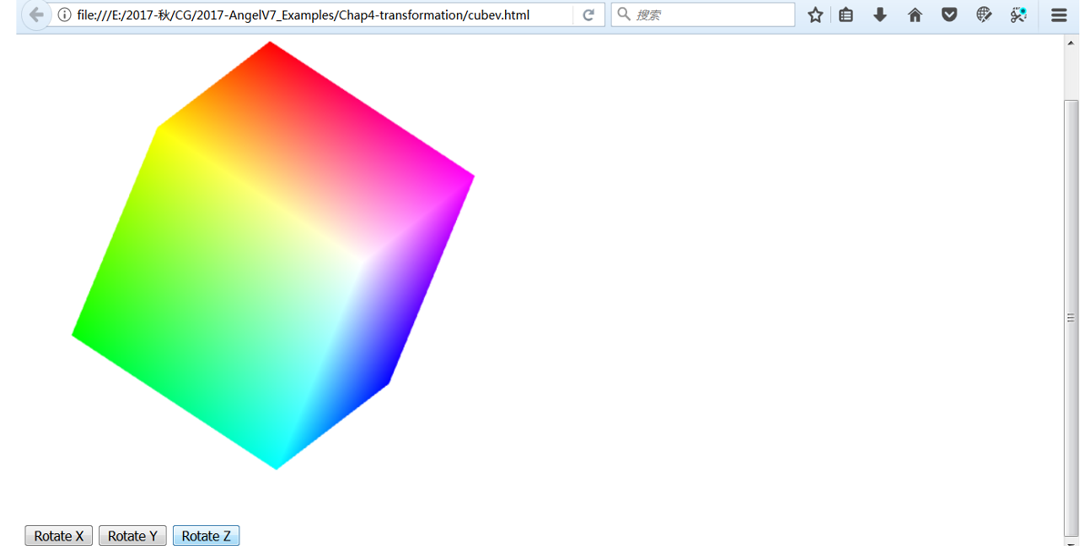
Cube / Cubev中的旋转实现
  <number>/57

Slide 23
Cube中的变换
  <number>/57
任何绕原点固定点的旋转，都可以分解成三个绕坐标轴的旋转，顺序可能不同，但是都可以分解实现。
R=R_{X} (thetaX)· R_{Y}(thetaY) ·R_{Z} (thetaZ)
P’=RP （CTM=R）
每次绘制时，三个旋转角中的某一个会增加一定的角度，至于增加哪一个旋转角由用户交互决定。
? Where apply transformation?
Notes:
Euler angles
Cube程序中，模-视变换矩阵就是立方体绕X轴，Y轴和Z轴的旋转变换矩阵的级联R，

Slide 24
Adding Buttons for Rotation
see cube.js
  <number>/57
分别控制三个旋转方向
var xAxis = 0;
var yAxis = 1;
var zAxis = 2;
var axis = 0;
var theta = [ 0, 0, 0 ];
var thetaLoc;
document.getElementById( "xButton" ).onclick = function () {axis = xAxis; };
document.getElementById( "yButton" ).onclick = function () {axis = yAxis; };
document.getElementById( "zButton" ).onclick = function () {axis = zAxis; };

Slide 25
Where apply transformation?
  <number>/57
  in application: compute new vertexs
  in vertex shader : send ModelView matrix
  in vertex shader: send angles
第一种方法
  在JS中计算CTM , 对图形进行变换生成新顶点，再发送给GPU显示处理。
  当顶点数据量大时，IO负荷太大，不采纳。
第二种方法
  在JS中计算CTM当前变换矩阵的16个数值并发送给GPU。
  传送数据大大减少，着色器中只需要用当前模式变换矩阵计算新顶点。
第三种方法（cube采用方法）
  在JS中计算三个方向的旋转角累积量的3个欧拉角数值，并发送给GPU。
  传送的数据更少，着色器需要根据参数生成当前变换矩阵，再计算新顶
  第三种方法非常适合现代GPU
  因为矩阵中三角函数运算在GPU中是硬编码（计算时间几乎可以忽略不计）
Notes:
Trig:trigonometry
Do we do trigonometry(三角) once in CPU or for every vertex in shader
GPUs have trig functions hardwired in silicon
选择后面这种方式原因：
三角函数运算在GPU中是硬编码，因此计算时间几乎可以忽略GPUs have trig functions hardwired in silicon。
Choice between second and third unclear
方法2发送16个数值，
方法3发送3个数值给着色器，

Slide 26
方法1 JS中计算新顶点
  <number>/57
第一种方法
  在JS中计算CTM , 对图形进行变换生成新顶点再发送给GPU显示处理。
  (原来的固定流水线法，数据传送量大，不采纳）
  //JS中实现的参考伪代码：
modelviewMatrix = mat4();
modelviewMatrix=mult(modelviewMatrix ,rotate(theta[xAxis]));
modelviewMatrix=mult(modelviewMatrix ,rotate(theta[yAxis]));
modelviewMatrix=mult(modelviewMatrix ,rotate(theta[zAxis]));
// CTM= modelviewMatrix =I* R_{X}R_{Y}R_{Z}
P= modelviewMatrix*P;
Render(P);

Slide 27
方法2： JS中计算矩阵并发送GPU
  <number>/57
  在JS中计算CTM当前变换矩阵（16个数值），并发送给GPU。
modelviewMatrix = mat4();//初始化未单位矩阵
Function render()
{ gl.clear(gl.COLOR_BUFFER_BIT|gl.DEPTH_BUFFER_BIT);
theta[axis]+=2;
modelviewMatrix=mult(modelviewMatrix ,rotate(theta[xAxis]));
modelviewMatrix=mult(modelviewMatrix ,rotate(theta[yAxis]));
modelviewMatrix=mult(modelviewMatrix ,rotate(theta[zAxis]));
gl.uniformMatrix4fv(modeViewMatrixLoc,false,flatten(modelviewMatrix));
gl.drawArrays(gl.TRIANGLES,0,numVertices);
requesetAnimFrame(render);
}
注： flatten把JS中基于行主顺的mat矩阵转换为列主序的Float32Array类型数据发送给vertex shader
Notes:
因此着色器可以正确得使用模视变换矩阵
黑板书写 CTM生成过程

Slide 28
方法2： 着色器中计算顶点
  <number>/57
attribute vec4 vPosition;
attribute vec4 vColor;
varying vec4 fColor;
uniform mat4 modelViewMatrix;
Void main()
{
gl_Position = modelViewMatrix * vPosition
}

Slide 29
方法3 ： JS中计算连续旋转角度并发送GPU
  <number>/57
  在JS中计算三个方向的旋转角累积量数组(3个数值)，并发送给shader。
function render(){
gl.clear( gl.COLOR_BUFFER_BIT |gl.DEPTH_BUFFER_BIT);
//当前旋转轴的旋转角度增加2，其它轴的角度不变
theta[axis] += 2.0;
gl.uniform3fv(thetaLoc, theta);//发送角度向量
gl.drawArrays( gl.TRIANGLES, 0, numVertices );
requestAnimFrame( render );
}
see cube.js

Slide 30
方法3 Shader中计算旋转矩阵
  <number>/57
顶点着色器中根据输入的旋转角度计算旋转变换矩阵
attribute vec4 vPosition;
attribute vec4 vColor;
varying vec4 fColor;
uniform vec3 theta;
void main() {
// Compute the sines and cosines of theta for each of
// the three axes in one computation.
  vec3 angles = radians( theta ); //转换为弧度
  vec3 c = cos( angles );
  vec3 s = sin( angles );
see cube.html
Notes:
注意：矩阵按列优先排，所以代码中的每一行对应矩阵的每一列数据
in vertex shader transform vertices
JS中用行优先排，但是在传递时用flatten进行了转置

Slide 31
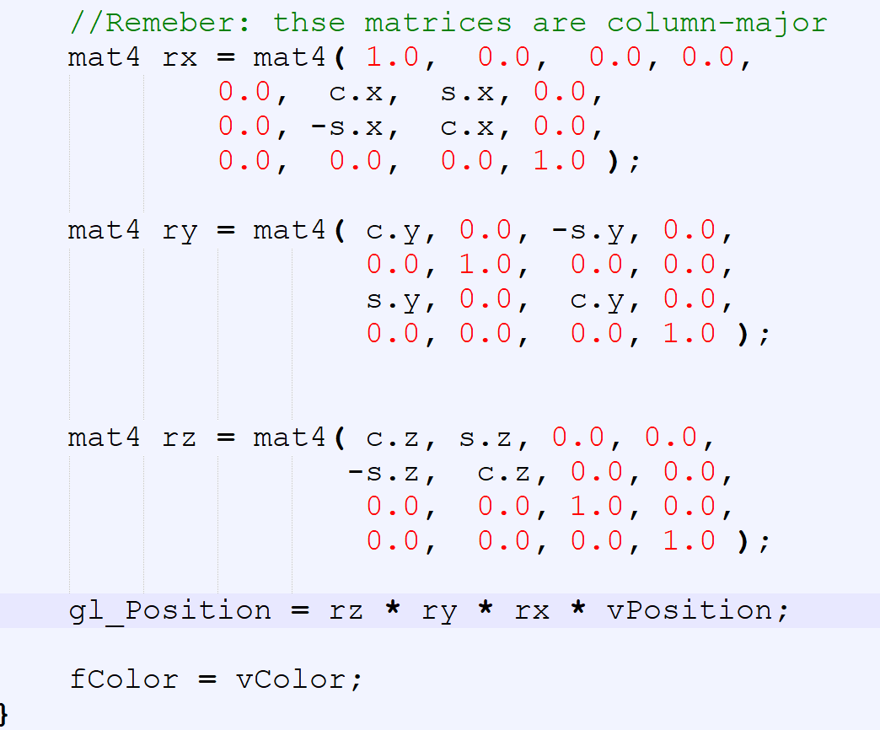
方法3 Shader中计算旋转矩阵(cont.)
  <number>/57
注意矩阵表示
列优先！
see cube.html
Notes:
只是把三种旋转按这里的顺序累乘后得到欧拉角（向量包含三个坐标轴旋转角度）。
观看程序运行，依次点各个按钮后，再点X旋转，图形并没有按X轴旋转

Slide 32

Outlines
  <number>/57
Representing a Mesh（*）
Transformation Cube（*）
Analog tracking ball（*）
Quaternions for Rotation
chap4.6 建模一个彩色立方体
chap 4.11~4.14: WEBGL如何实现变换~cube,trackball实例
Notes:
chap4.6 建模一个彩色立方体
chap 4.11~4.14: WEBGL如何变换

Slide 33
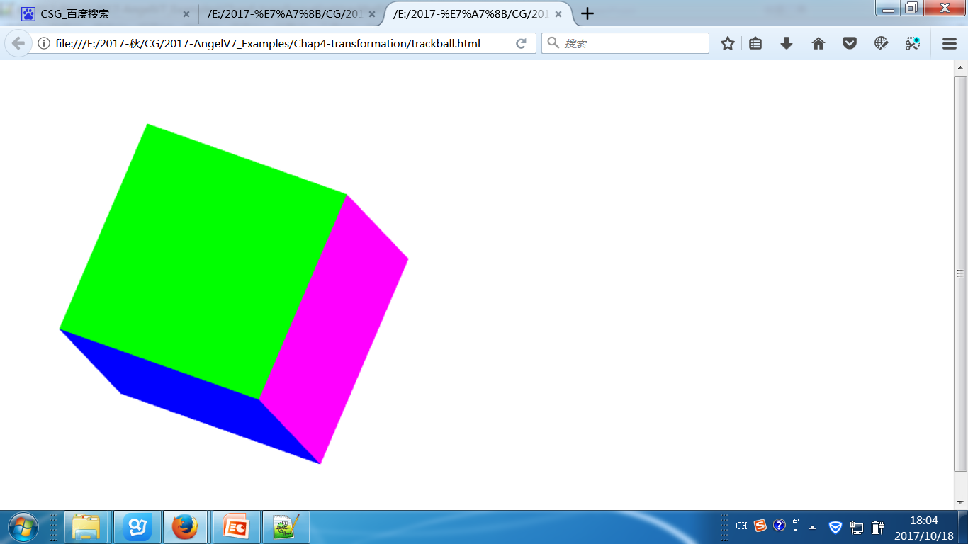
Trackball
  <number>/57
按用户希望的方向旋转并且是平滑连贯的旋转
See “trackball-correct”，原书给的例子有错？

Slide 34
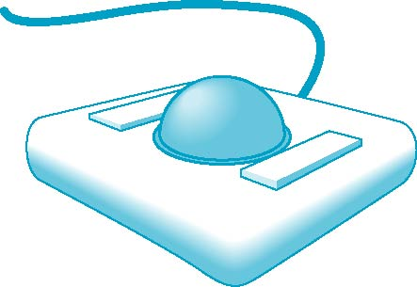
Interfaces
  <number>/57
how to use a two-dimensional device （such as a mouse） to interface with three dimensional objects
Some alternatives
  Virtual trackball（虚拟跟踪球）
  3D input devices such as the spaceball
  Use areas of the screen
Notes:
Example: how to form an instance matrix?
This is an optional lecture that
Introduces the use of graphical (virtual) devices that can be created using WebGL
Reinforce the benefit of not using direction angles and Euler angles
Makes use of transformations
Leads to reusable code that will be helpful later
The trackball is an “upside down” mouse
If there is little friction between the ball and the rollers, we can give the ball a push and it will keep rolling yielding continuous changes
Two possible modes of operation
Continuous pushing or tracking hand motion
连续推进或跟踪手运动
Spinning（旋转）

Slide 35
Smooth Rotation
  <number>/57
A Trackball from a Mouse
use transformations to move and reorient an object smoothly
  Problem: find a sequence of modelview matrices M₀,M₁,…..,M_{n}
  when they are applied successively to objects, we see a smooth transition.
Find the axis of rotation and angle of rotation of each Mi = Rotate（angle,axis))
Notes:
前面的cube，转动并不平滑，以不能重新定位（所见即所得）
For orientating an object, we can use Virtual trackball (see text)
the fact：every rotation corresponds to part of a great circle on a sphere

Slide 36
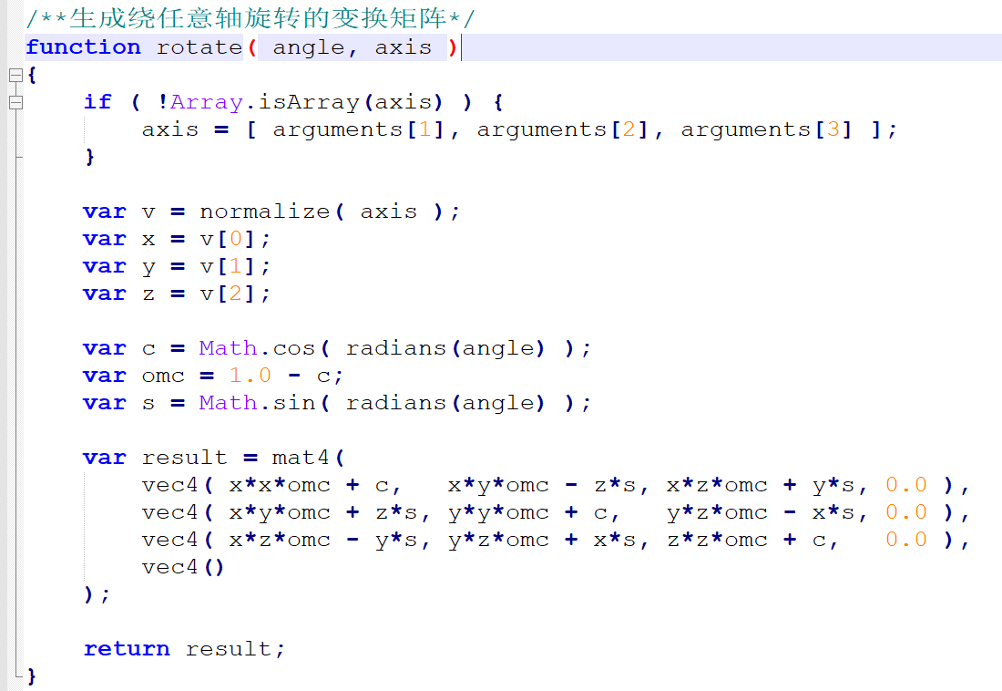
Specifying Rotation
  <number>/57
Mi = Rotate（angle,axis)) Pre 3.1 OpenGL had a function
glRotate (theta, dx, dy dz) //一般CG API 都会提供这一个函数！
the author~Angel implemented glRotate (theta, dx, dy dz) in \common\MV.js
Notes:
which incrementally changed the current rotation matrix by a rotation with fixed point of the origin about a vector in the direction (dx, dy, dz).
推到应该基本通绕任意轴的旋转，只是没有了平移变换而已。
因为平滑的旋转是一个旋转序列R₀,R₁,…..,R_{n}
而每个Ri的旋转角和轴都可能不同，所以需要在应用程序里生成Ri， 并且生成级联联旋转矩阵后，传递给顶点着色器，不同于cube中传递的是旋转角度

Slide 37
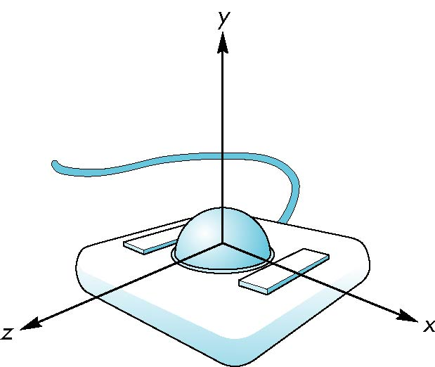
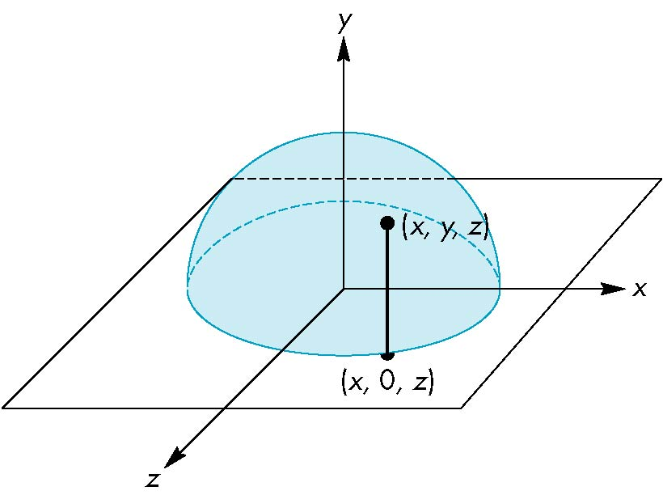
Projection of Trackball Position
  <number>/57
relate position on trackball to position on a normalized mouse pad by projecting orthogonally onto pad
将轨迹球的位置和在正常鼠标垫上的位置联系起来
origin at center of ball
Notes:
Trackball Frame

Slide 38
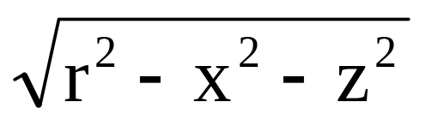
Reversing Projection
  <number>/57
A point (x,z) on the mouse pad
corresponds to
the point (x,y,z) on the upper hemisphere
where
y =
if r ≥ |x|≥ 0, r ≥ |z| ≥ 0
Notes:
词典 -------------------------------------------------------------------
reversing [ri'və:siŋ] 详细»
adj. 回动的
v. 颠倒；倒转；完全改变（reverse的ing形式）
Because both the pad and the upper hemisphere of the ball are two-dimensional surfaces, we can reverse the projection

Slide 39
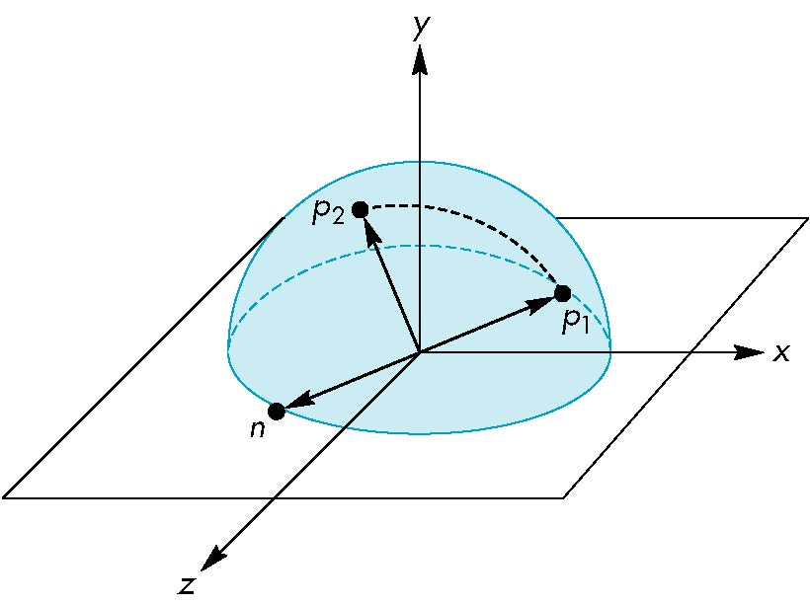
Computing Rotations
  <number>/57
two points that were obtained from the mouse.
project them up to the hemisphere to points p₁ and p_{2，}These points determine a great circle on the sphere.
Rotate from p₁ to p₂ by finding
the proper axis n of rotation
the angle between the points

Slide 40
Using the cross product
  <number>/57
旋转轴n：
The axis of rotation is given by the normal to the plane determined by the origin, p₁ , and p₂
n = p₁ × p₂

Slide 41
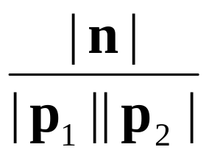
Obtaining the angle
  <number>/57
旋转角度The angle
between p₁ and p₂ is given by
| sin θ| =
If we move the mouse slowly or sample its position frequently, then θ will be small and we can use the approximation
θ ≈ sin θ
Notes:
法向量叉乘公式推导

Slide 42
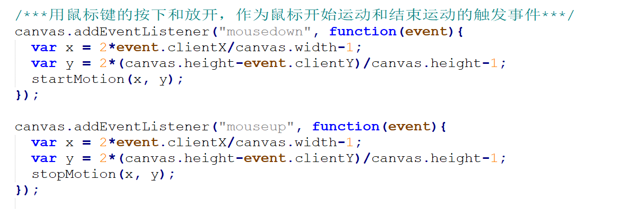
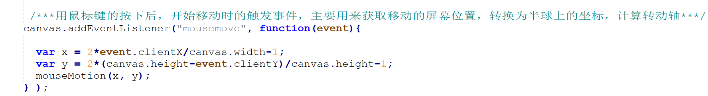
Implementing with WebGL
  <number>/57
Interaction Control~Mouse
Notes:
redrawContinue: if true, idle function posts a redisplay

Slide 43
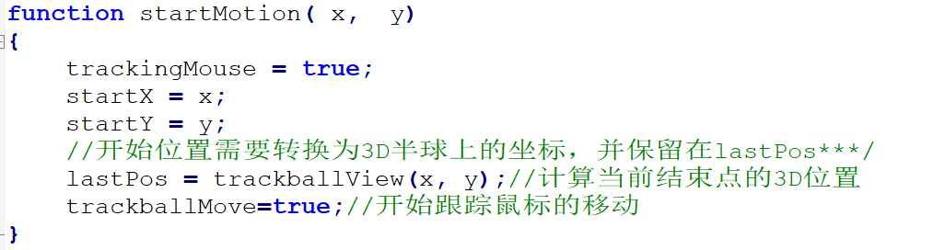
mouseDown回调函数
  <number>/57
Define actions in terms of two booleans
trackingMouse: if true, update trackball position
trackballMove: if true, update rotation matrix
  //开始跟踪鼠标移动：计算新的旋转轴和角度重新绘制图形

Slide 44
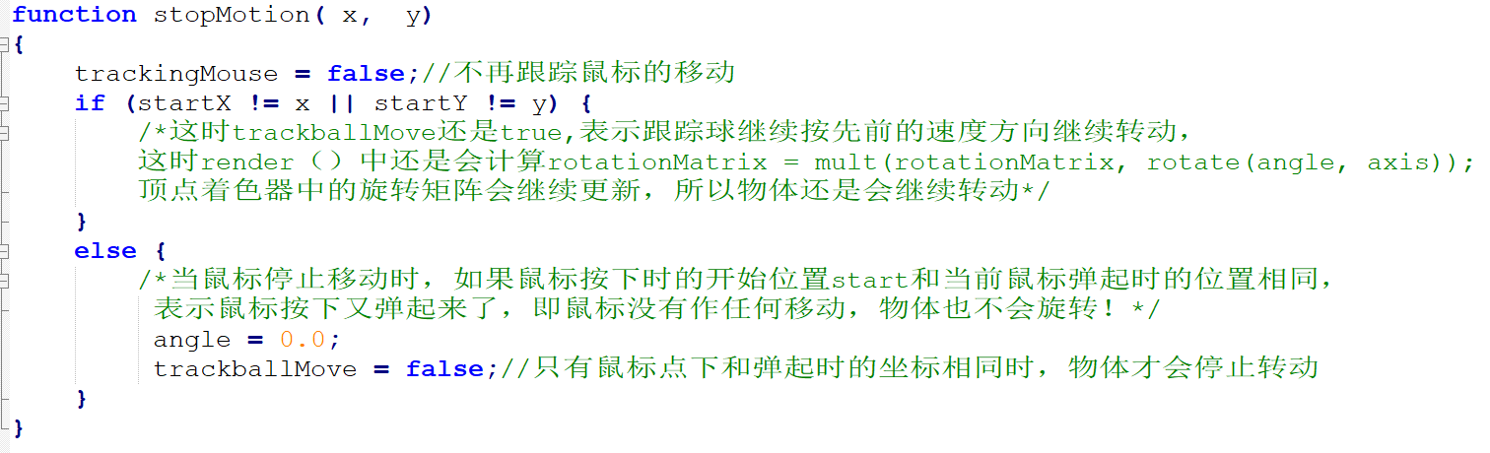
mouseUp回调函数
  <number>/57
Define actions in terms of two booleans
trackingMouse: if true, update trackball position
trackballMove: if true, update rotation matrix
//结束跟踪鼠标移动：不再重新计算，按原来的旋转方向速度继续旋转

Slide 45
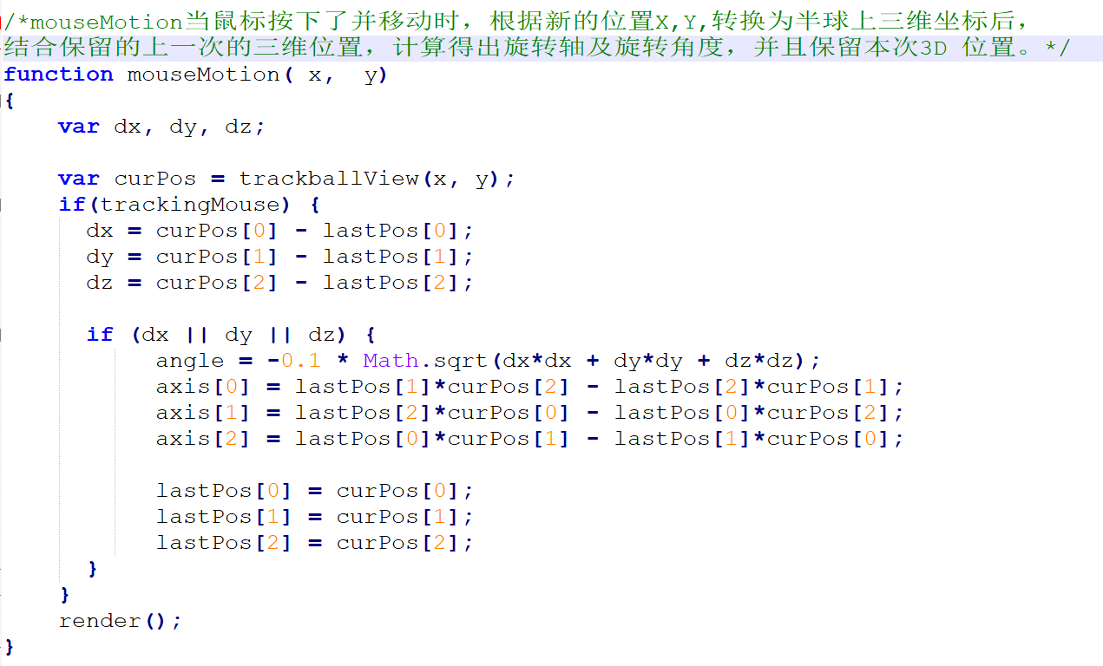
mouseMotion回调函数
  <number>/57
计算旋转轴和旋转角度，并调用绘制图形进行绘制

Slide 46
Trackball.js
  <number>/57
？ 红色代码是否正确
function render(){
gl.clear( gl.COLOR_BUFFER_BIT | gl.DEPTH_BUFFER_BIT);
if(trackballMove) {
//注意：rotate(angle, axis)是本次旋转， rotationMatrix是前面累积的旋转乘积
axis = normalize(axis);
rotationMatrix = mult(rotationMatrix, rotate(angle, axis));
gl.uniformMatrix4fv(rotationMatrixLoc, false, flatten(rotationMatrix));
}
gl.drawArrays( gl.TRIANGLES, 0, NumVertices );
requestAnimFrame( render );
}
Notes:
//鼠标键没有放开并继续移动时， 则根据新的旋转轴和角度得到新的一次旋转变换矩阵rotate(angle, axis)，它和前面的旋转变换rotationMatrix级联乘后，再将结果传递给GPU的顶点着色器使用。

Slide 47
Trackball shader
  <number>/57
<script id="vertex-shader" type="x-shader/x-vertex">
attribute vec4 vPosition;
attribute vec4 vColor;
varying vec4 fColor;
uniform mat4 rotationMatrix;
Void main(){
  vec4 p;
  gl_Position = rotationMatrix *vPosition;
  fColor = vColor;
}
</script>

Slide 48
Outlines
  <number>/57
Representing a Mesh（*）
Transformation Cube（*）
Analog tracking ball（*）
Quaternions for Rotation（option）
chap4.6 建模一个彩色立方体
chap 4.11~4.14: WEBGL如何实现变换~cube,trackball实例
Notes:
chap4.6 建模一个彩色立方体
chap 4.11~4.14: WEBGL如何变换

Slide 49
Quaternions四元数
  <number>/57
Extension of imaginary numbers from two to three dimensions（虚数的扩展）
Requires one real and three imaginary components i, j, k（一个实数，三个虚数）
Quaternions can express rotations on sphere smoothly and efficiently.
（可有效平滑得表达球体转动）
四元数处理旋转，Quaternion Rotation
q=q₀+q₁i+q₂j+q₃k
Notes:
Process:
Model-view matrix → quaternion变换矩阵表示成四元数
Carry out operations with quaternions
Quaternion → Model-view matrix
This is an optional lecture that
Illustrates the difference between using direction angles and Euler angles
Considers issues with incremental rotation
Introduces quaternions as an alternate to rotation matrices

Slide 50
Using Quaternions
  <number>/57
Quaternion arithmetic works well for representing rotations around the origin
Can use directly avoiding rotation matrices in the virtual trackball
Code was made available long ago (pre shader) by SGI
Quaternion shaders are simple

Slide 51




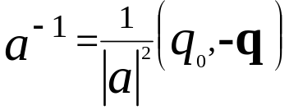
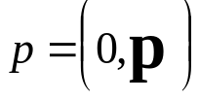
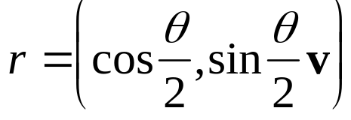
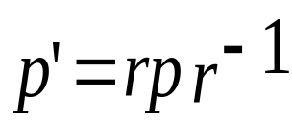
Quaterion Rotation
  <number>/57
四元数的计算公式
Definition:
Quaterian Arithmetic:
四元数表示：
Representing a 3D point:
Representing a Rotation:
Rotating a Point:

Slide 52
Incremental Rotation
  <number>/57
Consider the two approaches
  For a sequence of rotation matrices R₀,R₁,…..,R_{n} ,
  find the Euler angles for each and use R_{i}= R_{iz} R_{iy} R_{ix}
    Not very efficient
  Use the final positions to determine the axis and angle of rotation, then increment only the angle
Quaternions can be more efficient than either
Notes:
1方法：直接根据多次旋转累乘法，确定每个旋转变换（找欧拉角确定三个旋转）
2方法：直接找到最后旋转后的位置，确定最后的一个旋转变换（需要找旋转轴和累积旋转角度）
四元素方法比这两种方法都要高效

Slide 53
trackballQuaterion.js
  <number>/57
function render(){
gl.clear( gl.COLOR_BUFFER_BIT | gl.DEPTH_BUFFER_BIT);
if(trackballMove) {
axis = normalize(axis);
var c = Math.cos(angle/2.0);
var s = Math.sin(angle/2.0);
var rotation = vec4(c, s*axis[0], s*axis[1], s*axis[2]);
rotationQuaternion = multq(rotationQuaternion, rotation); gl.uniform4fv(rotationQuaternionLoc,flatten(rotationQuaternion));
}
gl.drawArrays( gl.TRIANGLES, 0, NumVertices ); requestAnimFrame( render );
}

Slide 54
Vertex Shader
trackballQuaterion.html
  <number>/57
传递入shader的是一次旋转矩阵的四元数表示 r
in vec4 vPosition;
in vec4 vColor;
out vec4 color;
uniform vec4 rquat; // rotation quaternion
//定义四元数乘法quaternion multiplier
//
vec4 multq(vec4 a, vec4 b)
{
return(vec4(a.x*b.x - dot(a.yzw, b.yzw),
a.x*b.yzw+b.x*a.yzw+cross(b.yzw, a.yzw)));
}
Notes:
用四元数表示的旋转矩阵rquat,实现顶点的旋转变换

Slide 55
Vertex Shader（cont.)
  <number>/57
用四元数表示的旋转矩阵rquat,实现顶点的旋转变换
// 定义四元数求逆inverse quaternion，为了求r-1
vec4 invq(vec4 a)
{ return(vec4(a.x, -a.yzw)/dot(a,a)); }
void main() {
vec3 axis = rquat.yxw;
float theta = rquat.x;
vec4 r, p;
p = vec4(0.0, vPosition.xyz); // input point quaternion
p = multq(rquat, multq(p, invq(rquat))); // rotated point quaternion
gl_Position = vec4( p.yzw, 1.0); // back to homogeneous coordinates
color = vColor;
}

Slide 56
Working with Quaternians
  <number>/57
Quaternion arithmetic works well for representing rotations around the origin
There is no simple way to convert a quaternion to a matrix representation
Usually copy elements back and forth between quaternions and matrices
Can use directly without rotation matrices in the virtual trackball
Quaternion shaders are simple

Slide 57
Quaternions and Computer Graphics
  <number>/57
(Re)discovered by both aerospace and animation communities
Used for head mounted display in virtual and augmented reality
Used for smooth camera paths
Caveat(警告):
  quaternions do not preserve up direction
Notes:
Caveat预告 告诫 警告

